Slide 1
Dissolved Organic Carbon: Fitting a Linear Model to Find Strong Predictors
Brock Carey, Devin Duran, Anna Ramsamy
CSI 2300 Final Project
December 14th, 2022

Slide 2
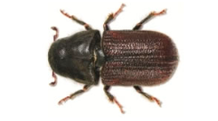
Introduction
Mountain pine beetles cause death of millions of acres of pine trees
One of many factors contributing to increased DOC
Dissolved Organic Carbon
Increased DOC in water sources
Harmful byproducts in drinking water
When combined with chlorine and other disinfectants
Carcinogens
Multiple linear regression analysis to find predictors of DOC
Variable selection using stepwise methods, LASSO

Slide 3
Methods
Linear regressions for independent variables
Heatmap
Stepwise selections
Forwards, backwards
LASSO fit
New linear regression with lasso variables
Relationships between variables and mean dissolved organic carbon

Slide 4
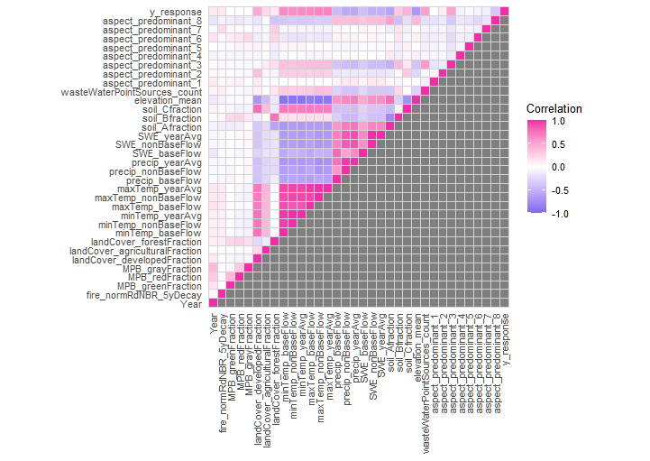
Correlation
Heatmap

Slide 5
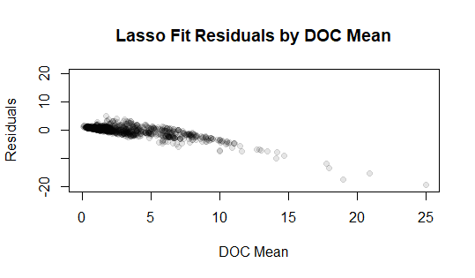
Lasso Fit Residual Plot

Slide 6
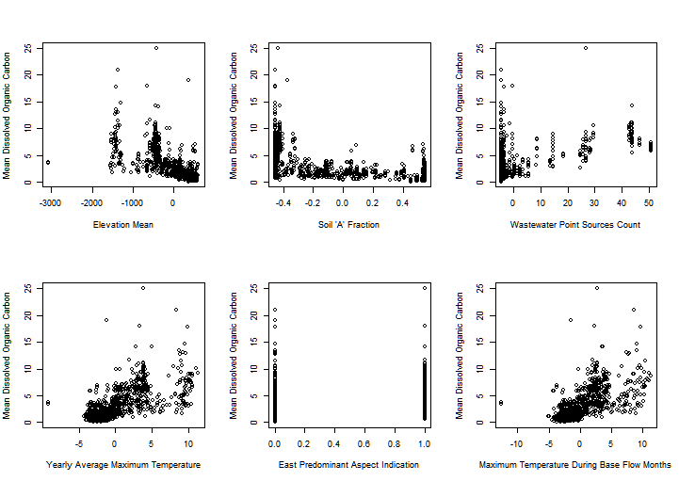
Final
Selected
Variables

Slide 7
Discussion
The selected variables had biological correlations with DOC
Soil A fraction, # of wastewater point sources, yearly average maximum temperature, maximum temperature during base flow months, mean elevation, and aspect predominant 3 (East)
Shockingly, the Mountain Pine Beetle variables were not chosen for any of the linear models
Lag between tree infestations and changes in DOC
Other environmental predictors were stronger
Possibly not a key contributor to increased DOC levels
A further exploration raised by the project is using non-linear modeling instead to decrease correlations between residuals and mean DOC
The independent variables of the final model can be used as indicators for areas where DOC concentrations are likely higher
Then waste management facilities can specialize disinfectants to area
To limit water contamination

